Slide 1
Ensemble Learning
By Madhur Jain

Slide 2






Example
I want to invest in a company XYZ. I am not sure about its performance though.
So, I look for advice on whether the stock price will increase more than 6% per annum or not?
I decide to approach various experts having diverse domain experience:
Employee’s of Company
Financial Advisor of Company XYZ
Stock Market Trader
Social Media Expert
Company’s Management

Slide 3
Example
1. Employee of Company XYZ: This person knows the internal functionality of the company and have the insider information about the functionality of the firm. In the past, he has been right 70% times.
2.Financial Advisor of Company XYZ: This person has a broader perspective on how companies strategy will fair of in this competitive environment. In the past, he has been right 75% times.
3.Stock Market Trader: This person has observed the company’s stock price over past 3 years. He knows the seasonality trends and how the overall market is performing. In the past, he has been right 70% times.
4. Market Research team in same segment: This team analyzes the customer preference of company XYZ’s product over others and how is this changing with time. In the past, they have been right 75% of times.
5. Social Media Expert: This person can help us understand how has company XYZ has positioned its products in the market. And how are the sentiment of customers changing over time towards company. He is unaware of any kind of details beyond digital marketing. In the past, he has been right 65% of times.
In a scenario when all the 5 experts/teams verify that it’s a good decision(assuming all the predictions are independent of each other), we will get a combined accuracy rate of
1 - 30%*25%*30%*25%*35% ➔99.92125%

Slide 4
What is Ensemble Learning?
Ensemble is the art of combining diverse set of learners (individual models) together to improvise on the stability and predictive power of the model. In the past example, the way we combine all the predictions together will be termed as Ensemble Learning.
Models can be different from each other for a variety of reasons, starting from the population they are built upon to the modeling used for building the model.
Here are the top 4 reasons for a model to be different. They can be different because of a mix of these factors as well:
1. Difference in population
2. Difference in hypothesis
3. Difference in modeling technique
4. Difference in initial seed

Slide 5
Ensemble Learning Techniques
Simple Ensemble learning Technique
Voting
Averaging
Weighted Averaging
Bagging
Boosting
Stacking

Slide 6
Simple Ensemble Techniques
Max Voting : The max voting method is generally used for classification problems. In this technique, multiple models are used to make predictions for each data point. The predictions by each model are considered as a ‘vote’. The predictions which we get from the majority of the models are used as the final prediction.
“VotingClassifier” module in sklearn can be used for Max voting.

Slide 7
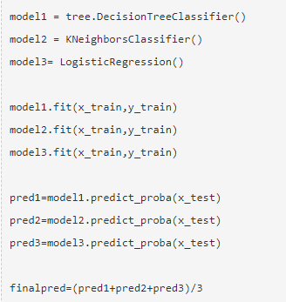
Simple Ensemble Techniques
Averaging : Take an average of predictions from all the models and use it to make the final prediction. Averaging can be used for making predictions in regression problems or while calculating probabilities for classification problems.
Averaging

Slide 8
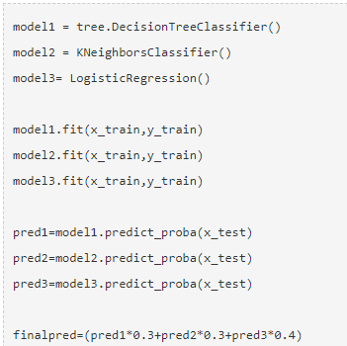
Simple Ensemble Techniques
Weighted Average : This is an extension of the averaging method.
All models are assigned different weights defining the importance of each model for prediction.
Weighted Average

Slide 9
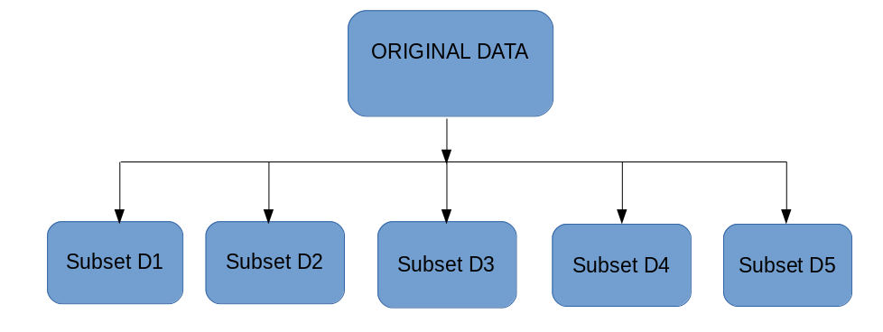
Bagging
The idea behind bagging is combining the results of multiple models to get a generalized result. Here’s a question: If you create all the models on the same set of data and combine it, will it be useful? There is a high chance that these models will give the same result since they are getting the same input. So how can we solve this problem? One of the techniques is bootstrapping.
Bootstrapping is a sampling technique in which we create subsets of observations from the original dataset, with replacement. The size of the subsets is the same as the size of the original set.
Bagging (or Bootstrap Aggregating) technique uses these subsets (bags) to get a fair idea of the distribution (complete set). The size of subsets created for bagging may be less than the original set.

Slide 10
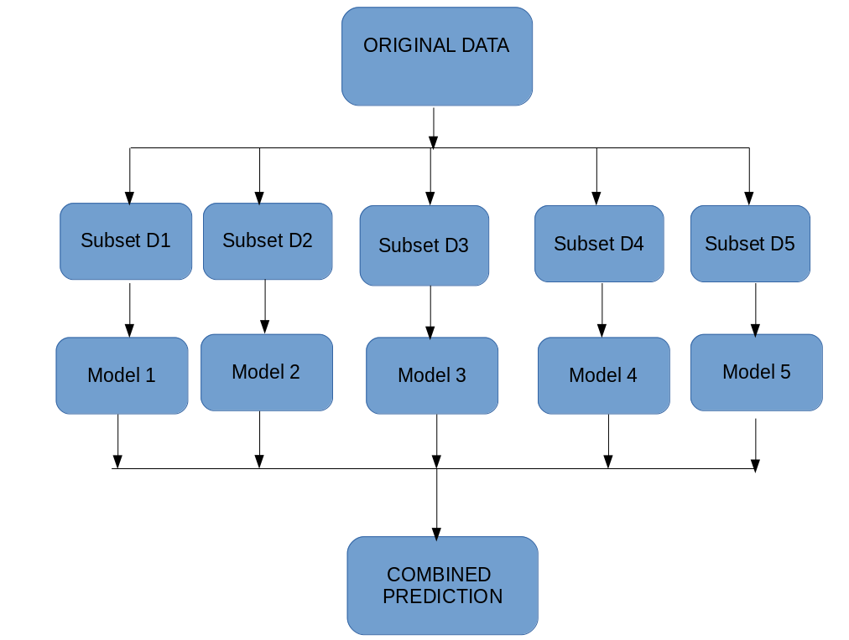
Bagging
Multiple subsets are created from the original dataset, selecting observations with replacement.
A base model (weak model) is created on each of these subsets.
The models run in parallel and are independent of each other.
The final predictions are determined by combining the predictions from all the models.

Slide 11
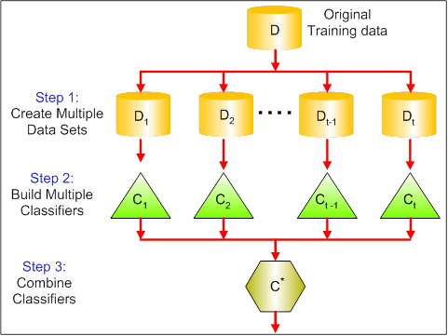
Bagging
Bagging : (stands for Bootstrap Aggregating) is a way to decrease the variance of your prediction by generating additional data for training from your original dataset using combinations with repetitions to produce multisets of the same cardinality/size as your original data. By increasing the size of your training set you can't improve the model predictive force, but just decrease the variance, narrowly tuning the prediction to expected outcome.
Bagging tries to implement similar learners on small sample populations and then takes a mean of all the predictions. In generalized bagging, you can use different learners on different population. As you can expect this helps us to reduce the variance error.
Features
parallel ensemble: each model is built independently
Aim to decrease variance, not bias
Suitable for high variance low bias models (complex models)
An example of a tree based method is random forest, which develop
fully grown trees.

Slide 12
Boosting
Boosting is an iterative technique which adjust the weight of an observation based on the last classification. If an observation was classified incorrectly, it tries to increase the weight of this observation and vice versa.
Boosting decreases the bias error and builds strong predictive models. However, they may sometimes over fit on the training data.
Features
sequential approach: Tries to add new models that do well where previous models lack
Aim’s to decrease bias, not variance
Suitable for low variance high bias models
Gradient boosting

Slide 13
Algorithms based on Bagging and Boosting
Bagging and Boosting are two of the most commonly used techniques in machine learning.
Following are the algorithms we will be focusing on:
Bagging algorithms:
Bagging meta-estimator
Random forest
Boosting algorithms:
AdaBoost
GBM
XGBM

Slide 14
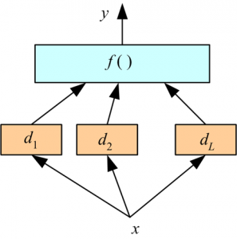
Stacking
Stacking : Stacking is an ensemble learning technique that uses predictions from multiple models (for example decision tree, knn or svm) to build a new model. This model is used for making predictions on the test set.
Here we use a learner to combine output from different learners. This can lead to decrease in either bias or variance error depending on the combining learner we use.
Introducing a meta-level and use another model/approach to estimate the input together with outputs of every model to estimate the weights or, in other words, to determine what models perform well and what badly given these input data

Slide 15
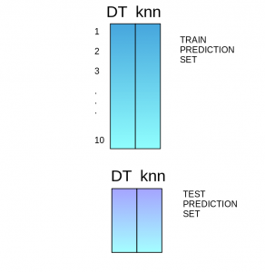
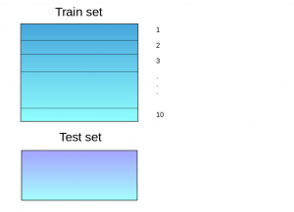
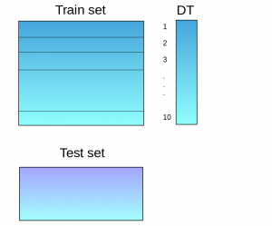
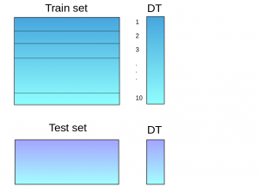
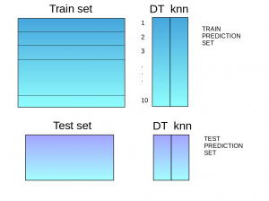
Stacking Steps
The train set is split into 10 parts.
A base model (suppose a decision tree) is fitted on 9 parts and predictions are made for the 10th part. This is done for each part of the train set.
The base model (in this case, decision tree) is then fitted on the whole train dataset.
Using this model, predictions are made on the test set.
Steps 2 to 4 are repeated for another base model (say knn) resulting in another set of predictions for the train set and test set.
The predictions from the train set are used as features to build a new model.
This model is used to make final predictions on the test prediction set.

